Slide 1
CSc 134
Database Management Systems
12. XML
Ying Jin
Computer Science Department
California state University, Sacramento

Slide 2
Introduction
HTML is widely used → not suitable for specifying structured data that is extracted from databases.
XML (eXtended Markup Language) has emerged as the standard for structuring and exchanging data over the Web.
XML:
  structure and meaning of the data
  rather than just specifying how the Web pages are formatted for display on the screen.

Slide 3
Structured Data
Structured Data
  Represented in a strict format
  Information stored in databases
  The DBMS then checks to ensure that all data follows the structures and constraints specified in the schema.

Slide 4
Unstructured Data
Unstructured data
  There is very limited indication of the type of data.
  Web pages in HTML that contain some data are considered as unstructured data.

Slide 5
Semi Structured Data
This data may have a certain structure, but not all the information collected will have identical structure.
This type of data is known as semi-structured data.
  The schema information is mixed in with the data values.

Slide 6
Structure vs. semi-structure
Key difference:
  How the schema constructs are handled
Whether the schema information is mixed in with the data values

Slide 7
Semi Structured Data (cont.)
Tree model (graph)
The labels or tags on the directed edges represent the schema names—the names of attributes, object types (or entity types or classes), and relationships.
  E.g. <Name> <Location>
The internal nodes represent individual objects or composite attributes.
The leaf nodes represent actual data values of simple (atomic) attributes.

Slide 8
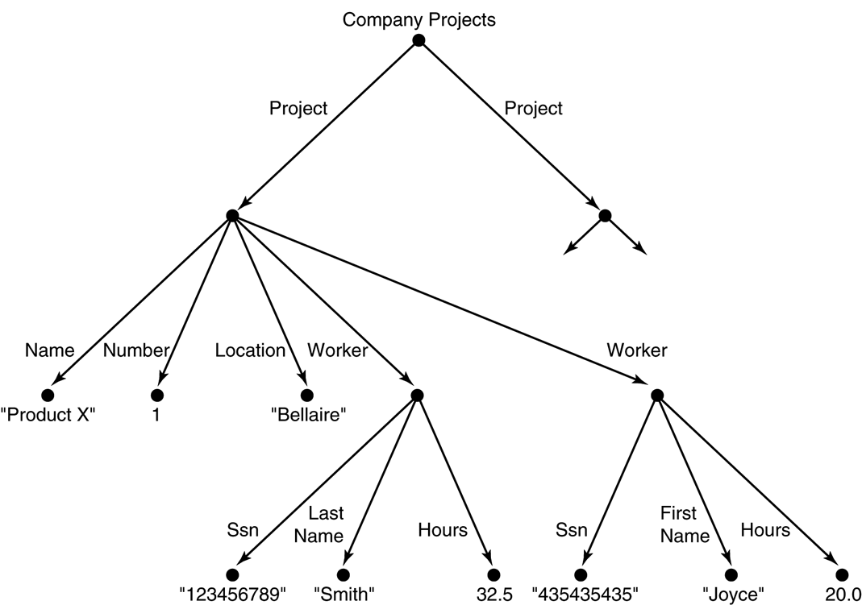
Representing semistructured data as a graph.

Slide 9
XML Hierarchical (Tree) Data Model
Elements are identified by their start tag and end tag.
The tag names are enclosed between angled brackets <…>, and end tags are further identified by a backslash </…>.
Complex element
  E.g. <project>…</project>
Simple element
  E.g. <Location>Bellaire</Location>

Slide 10
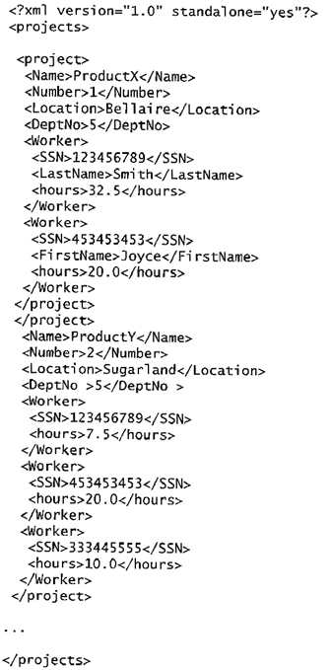

Slide 11
Well-Formed XML Documents
It must start with an XML declaration to indicate the version of XML being used—as well as any other relevant attributes.
It must follow the syntactic guidelines of the tree model.
  single root element
  a matching pair of start tag and end tag
A well-formed XML document is syntactically correct.
  This allows it to be processed by generic processors that traverse the document and create an internal tree representation.

Slide 12
Valid XML Documents
A stronger criterion is for an XML document to be valid.
the document must be well-formed, AND
the element names used in the start and end tag pairs must follow the structure specified in a separate XML DTD (Document Type Definition) file or XML schema file.

Slide 13
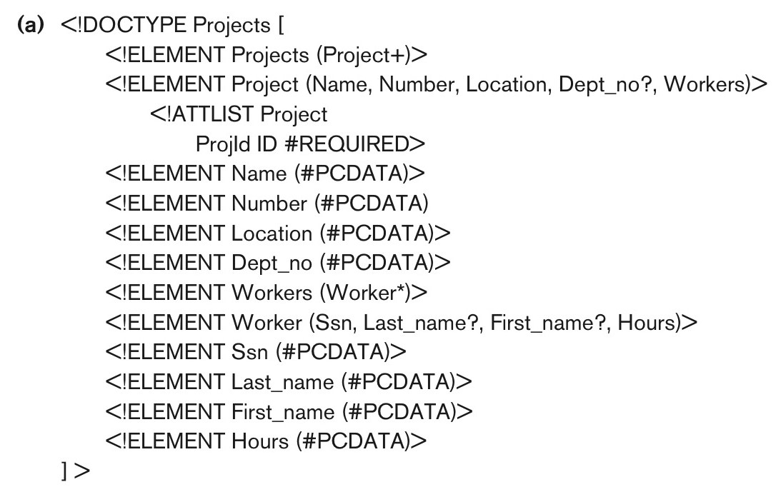
DTD (Document Type Definition)

Slide 14
DTD Example
<!ELEMENT Workers (worker*)>
<!ELEMENT Projects(Project+)>
<!ELEMENT Project (Name,..Dept_no?..)>
<!ELEMENT hours(#PCDATA)>
<!ATTLIST Project
projId ID #REQUIRED>
*: can be repeated 0 or more times (optional multivalued (repeating) element)
+: One or more times (required multivalued (repeating) element
?: 0 or one time (optional single-valued (nonrepeating) element)
PCDATA: A leaf node
For P.K. Can be referenced using IDREF

Slide 15
Relational Schema
Department(DeptId,Dname)
Dept_location(DeptID, Location)
Project(ProjId,PName,Location)
Employee(EmpId, deptId,Ename,Job, Salary, proj) foreign key (deptId) references Department(DeptId)
foreign key (proj) references Project(ProjId)
Employee and Project: many to many. Same in XML
  Works_on(employId,projId) foreign key (employId) references Employee(EmpId) foreign key(projId) references Project(ProjId)

Slide 16
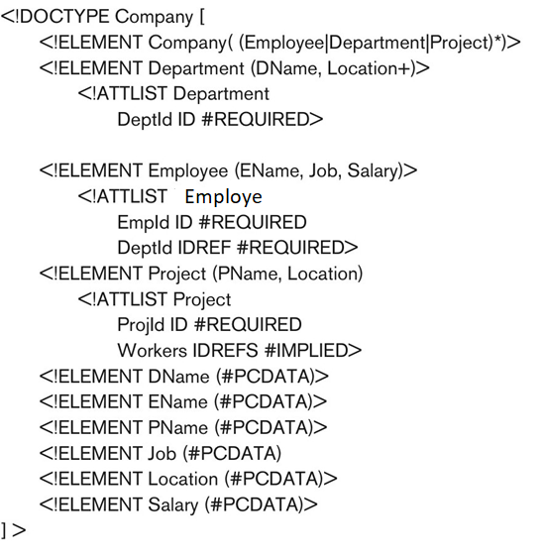

Slide 17
Details
(Employee|Department|Project)
  Either Employee, Department, or Project can appear in the document
DeptId IDREF #REQUIRED
Workers IDREFS #IMPLIED
  This attribute is optional

Slide 18
Including DTD
<?xml version=“1.0” standalone=“no”?>
<!DOCTYPE Projects SYSTEM “proj.dtd”>
DTA

Slide 19
XML Schema
DTD has its own special syntax requires specialized processors
XML schema language is a standard for specifying the structure of XML documents

Slide 20
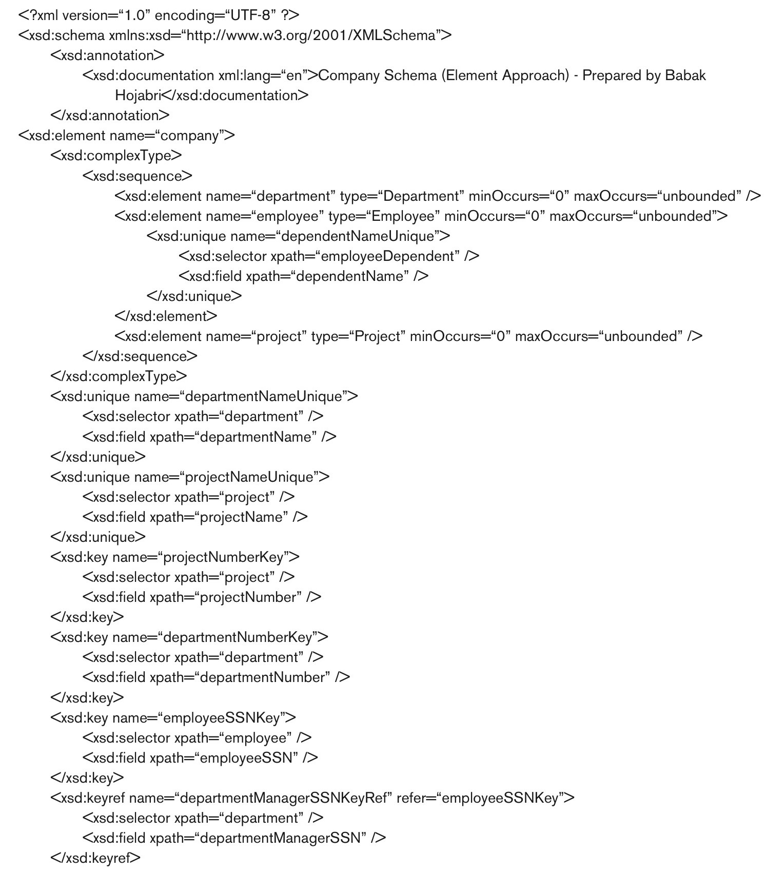

Slide 21
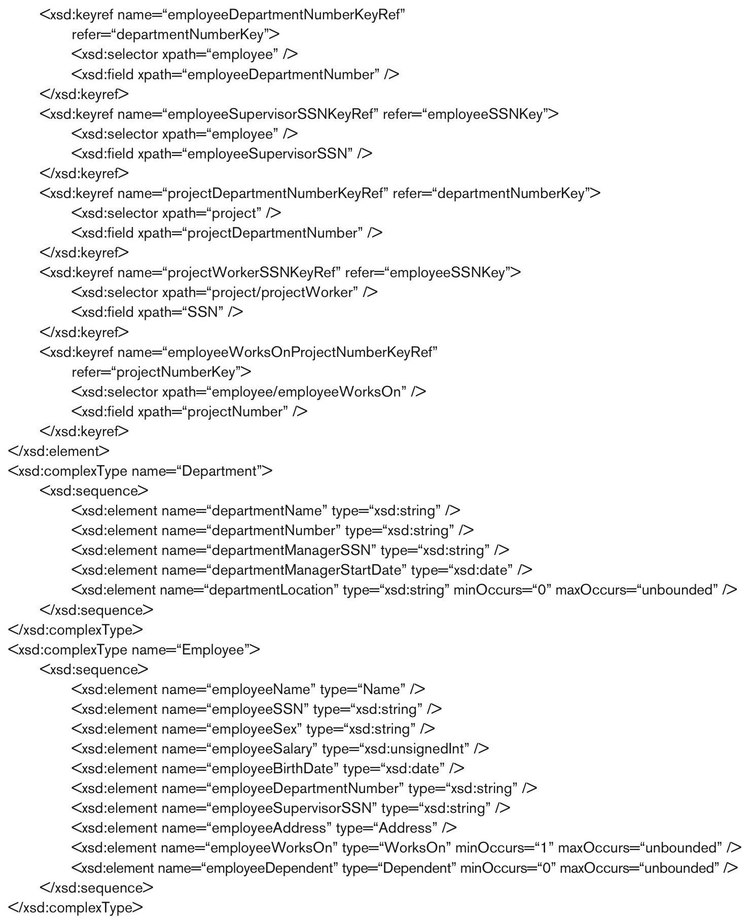
continued on next slide

Slide 22
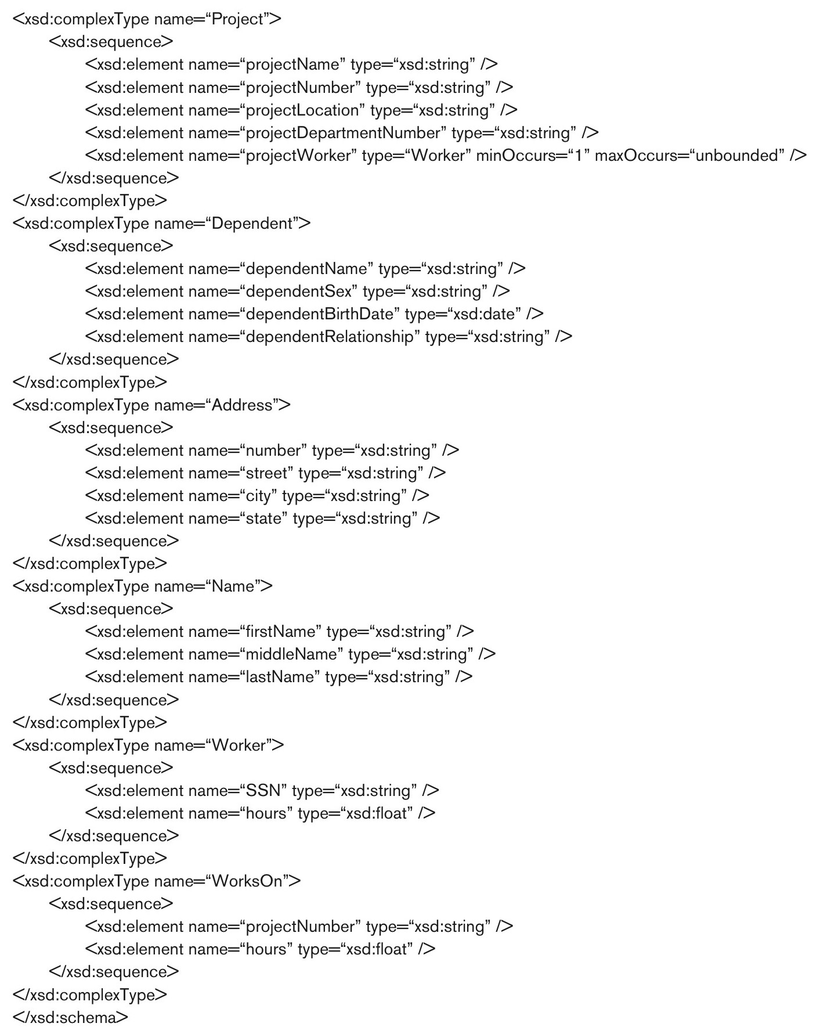

Slide 23
Name space
xsd: XML schema description
Xmlns: XML name space
  Standard XML schema command http://www.w3.org/2001/XMLSchema
  Defines the set of commands(names) that can be used, such as xsd:element

Slide 24
Annotation
xsd: annotation
  Provide comments
xml:lang
  Language used

Slide 25
Elements and types
xsd:element tag:
  Specify element name
Root element
  Company
  Type: xsd:complexType

Slide 26
Elements
First level elements
  employee, department, project
Element type
  Type=“xsd:string”
Min max occurences

Slide 27
Keys
xsd:unique
  Unique attribute
xsd:key
  Primary key
Xsd: keyref
  Foreign key

Slide 28
Composite attributes
<xsd:element name=“employeeAddress” type=“address”/>
Address defined (page 22)

Slide 29
These slides are based on the textbook:
R. Elmaseri and S. Navathe, Fundamentals of Database Systems, 7th Edition, Addison-Wesley..

